Slide 1
Mary Anning Working with Fossils

Slide 2
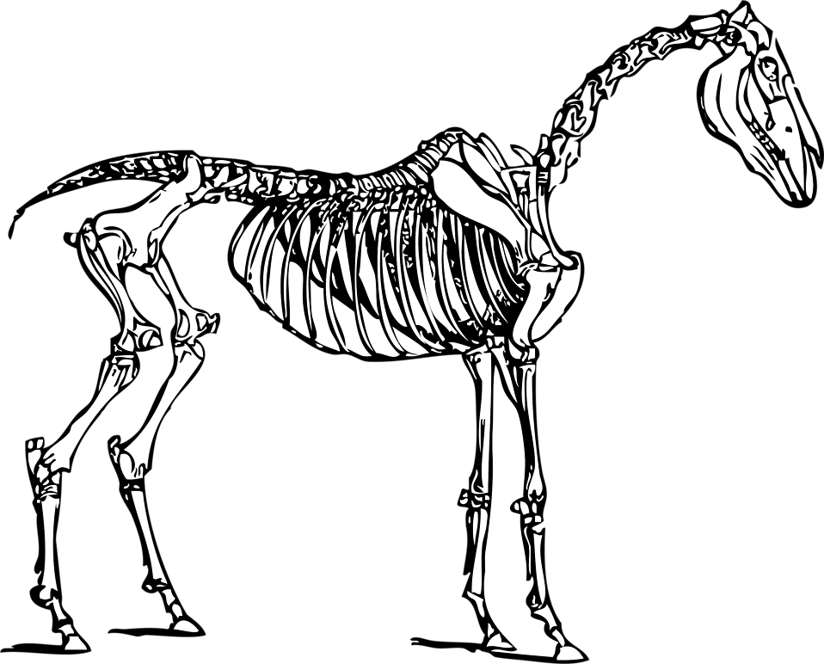
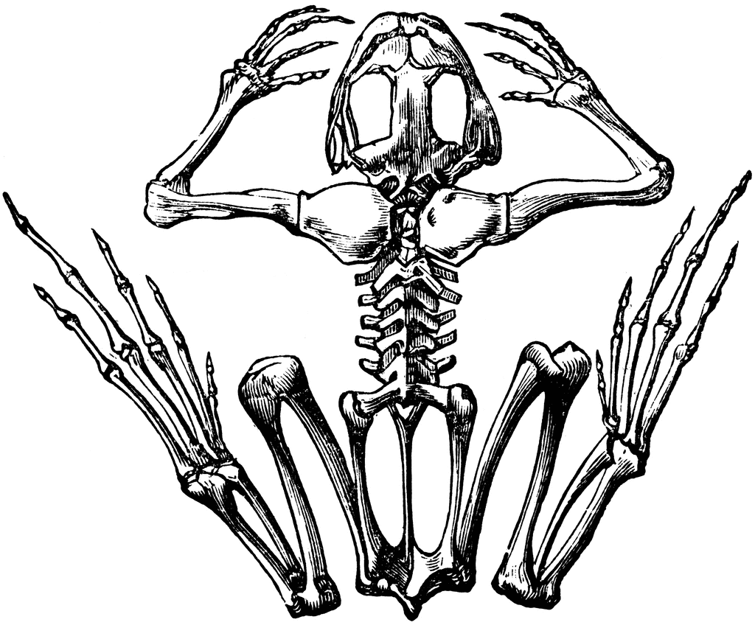
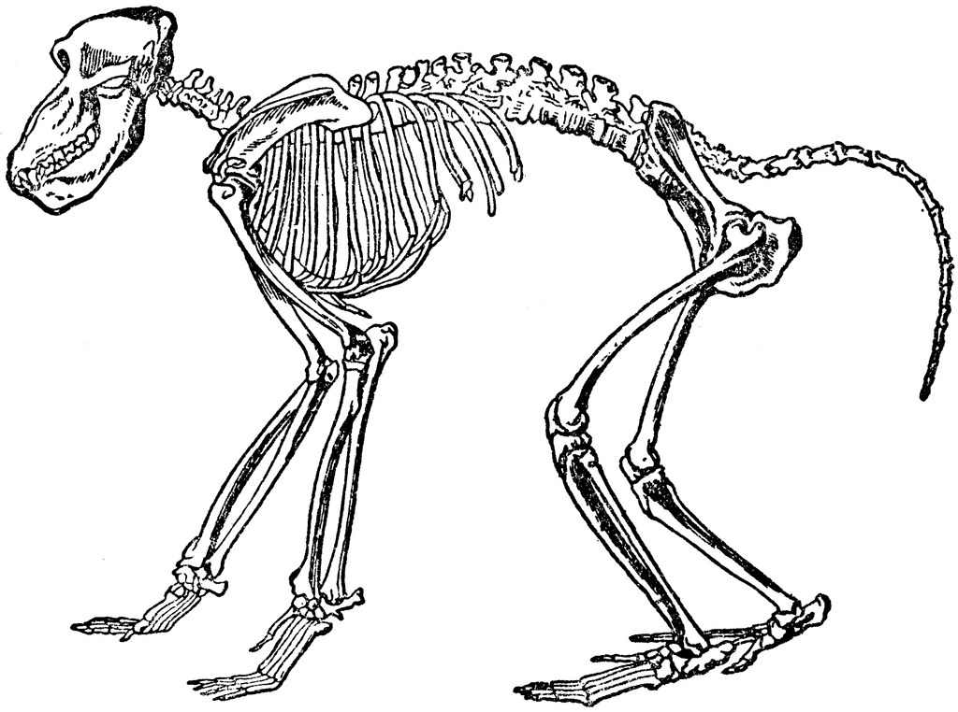
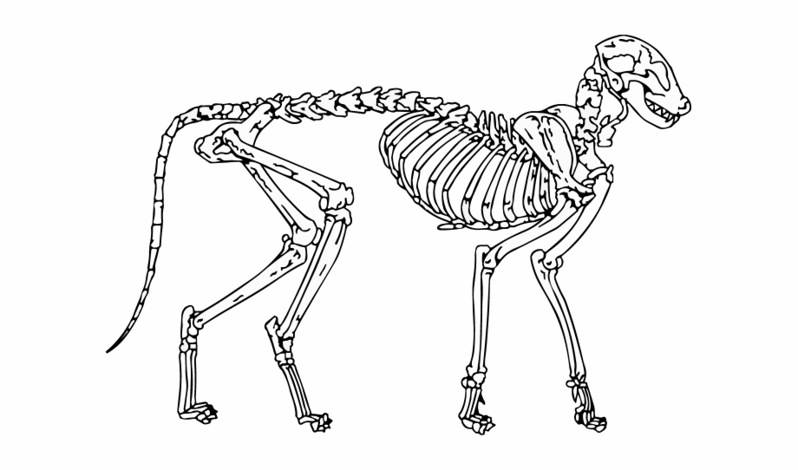
Which animal has a skeleton like this?
Slide 1

Slide 3
Which animal has a skeleton like this?
frog
horse
baboon
cat
Slide 2

Slide 4
Raptor
Slide 3

Slide 5
Photo Credits: Mary Anning – Wikipedia Public Domain Skeletons – clipart-library.com Raptor – Jules Pottle
© HMDT Music 2020

